Slide 1
CUSTOMER CHURN PREDICTION
Presenter:-
Padmavati Vijay Sumare. 21UAD063
Aditi Kishor Pawar. 21UAD053
Sakshi Ratan Shirote. 21UAD062
Manali Narayan Thombre. 21UAD065

Slide 2
ovERVIEw :-
Understanding the reasons behind customer churn is critical to sustaining a healthy business. Knowing how and why customers leave and what can be done to win them back is vital for putting in targeted efforts to enhance customer retention and business growth. As a data-driven process, churn management has matured into a mission-critical task that companies depend on to make sense of the market.
It is a signicant concern for businesses in various industries, including telecommunications, Software-as-a-service (SaaS), e-commerce, and more. Understanding and managing customer churn is essential for sustainable growth and maintaining a healthy customer base.

Slide 3
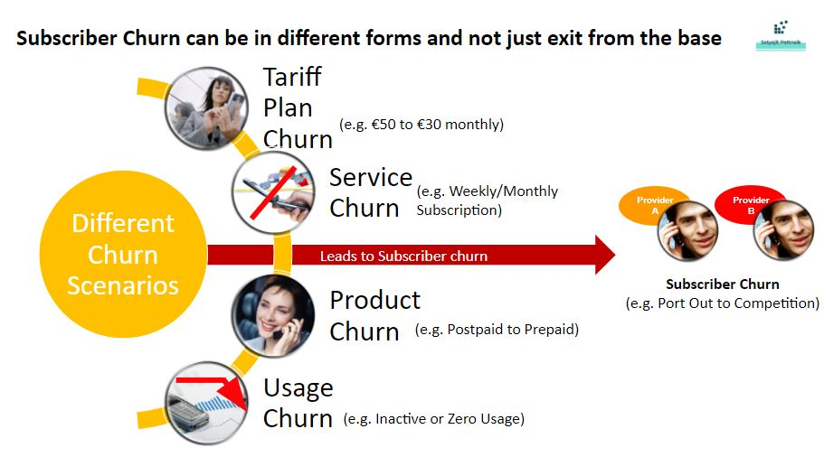

Slide 4
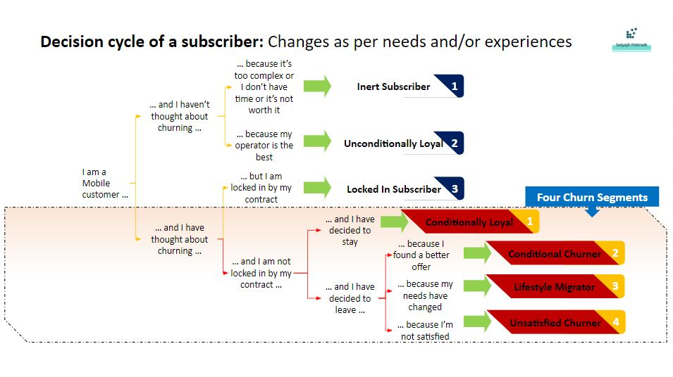

Slide 5
methods :-
1.Data Collection and Preprocessing.
2.Exploratory Data Analysis (EDA).
3.Feature Enginnering.
4.Modelling Techniques.
5.Model Deployment and Monitoring.

Slide 6
Data collection and preprocessing
Data Collection :-Collect relevant data such as customer demographs,usage patterns,customer interactions,etc.
Data Preprocessing :-
1.Cleaning data - a) Data Imputation.
b)Outlier Detection.
c)Validation.
2.Handling categorical variables - a)One-hot encoding.
b)Label encoding.
3.Data splitting – a)Training dataset.
b)Validation dataset.
c)Testing dataset.
4.Addressing imbalance – a) Upsampling and Downsampling Methods.

Slide 7
Exploratory data analysis
1.Conduct exploratory data analysis to understand the distribution of variables,
Identify patterns,correlations, and anomalies in the data.
2.Visualize key metrices and relationships using techniques like histograms,scatter plots,box plots etc.
3.Understanding univariate and bivariate analysis of variables.

Slide 8
Modelling techniques
1)Utilize various machine learning algorithms such as logistic regression,decision trees classifier,random forest classifier,smoteen analysis to build a predictive model.
2)Evaluate model performance using metrices like accuracy,precision,recall,
f1-score.
3)Ensemble techniques like bagging or boosting can be employed to improve model performance.

Slide 9
Model deployment & monitoring
1)Deploy the predictive model into the production environment where it can be used to score new customers.
2)Implement monitoring mechnisms to track model performance over time and update model as needed.
3)Measure model performance in terms of accuracy ,working etc.

Slide 10
Thank you…!

